Slide 1
Capacitated Team Orienteering Problem (CTOP)
Clarke-Wright Savings + Hybrid Adaptive Large Neighbourhood Search
Team: Georgios Moschovis, Odysseas Kerasaridis, Andreas Nikolaos Kyprianou
AUEB | Operations Research & Computational Intelligence | 26 May 2026

Slide 2




HALNS Solution Methodology
Algorithm Pipeline:
Phase 1
Phase 2
Clarke-Wright Greedy
ALNS + Simulated Annealing — 280s
Phase 3
Phase 4
Set Packing Problem (Gurobi) — 30s
Final Polish
Problem-Specific Strategies:
P1: No Mandatory Nodes → seed=16
P2: 24 Mandatory Nodes → seed=15
Each problem runs the full pipeline independently with optimized parameters.

Slide 3


Greedy Initialisation + ALNS Destroy-and-Repair
Phase 1: Clarke-Wright Savings
Phase 2: ALNS Loop (280 seconds)
Single-node routes for all feasible customers
Savings score:
Greedy merging by score; keep top K=5 routes
Cheapest-insertion fill to exploit remaining capacity
P2: mandatory nodes placed first
Each iteration:
Select 1 of 7 destroy operators via roulette wheel
Remove q nodes from current solution
Select 1 of 5 repair operators; reinsert nodes
Apply 2-opt + fill (light local search)
Accept via Simulated Annealing: , T decays x0.9997/iter
Every 300 iters: update operator weights toward productive ones
Weights steer search toward operators currently finding improvements — the algorithm learns on the fly.

Slide 4

Phase 3 — Set Packing Problem via Branch-and-Cut
What the pool is: Throughout the ALNS, every improving solution adds its routes to a shared pool (up to 50,000 unique routes). The pool captures high-quality routes from every phase of the search.
Mathematical Formulation:
Gurobi solves this via LP relaxation → clique cuts on the conflict graph → branch-and-cut on fractional z_r variables. Time limit: 30 seconds.
Timeline:
ALNS running → pool grows
T_min reached mid-run → SPP fires → temperature reheats → ALNS continues
ALNS ends → final SPP on full pool
Polish
SPP recombines routes from different phases — something the ALNS alone can never do.

Slide 5
Critical Parameters and Tuning
TUNED INDEPENDENTLY PER PROBLEM VIA OPTUNA (TPE SAMPLER)
Parameter
Problem 1 (No Mandatory)
Problem 2 (24 Mandatory)
Seed
16
15
COOLING
0.999188
0.999574
T0_FRAC
0.051659
0.094243
SEGMENT_SIZE
300
600
REACT
0.163320
0.209976
BETA_MAX_FRAC
0.192933
0.175359
SCORE_BEST
15
11
SCORE_BETTER
6
7
SCORE_ACCEPT
0
3
Key Insight:
P1 and P2 have structurally different search landscapes. P2 requires slower cooling (0.999574 vs 0.999188) and larger segment size (600 vs 300) to navigate the harder mandatory-node constrained space. Seed selection confirmed via exhaustive scan over {4, 8, 15, 16, 23, 42}.

Slide 6
Results: HALNS vs Greedy Baseline
Metric
Problem 1 — No Mandatory
Problem 2 — 24 Mandatory
Greedy profit
7,048
5,167
HALNS final profit
8,579
7,678
Improvement
+21.7%
+48.5%
All routes
130/130 capacity (×5)
130/130 capacity (×5)
Bottleneck
Capacity (not time)
Capacity (not time)
The Hybrid Adaptive Large Neighbourhood Search (HALNS) algorithm demonstrates significant improvements over the Greedy baseline, achieving a final profit of 8,579 for Problem 1 and 7,678 for Problem 2. This represents a 21.7% improvement for Problem 1 and a substantial 48.5% improvement for Problem 2.
Key Insight: All 5 routes are capacity-maxed in both problems. Most routes have 50–200 time units spare. The binding constraint is capacity, not time.

Slide 7
HALNS: Hybrid Adaptive Large Neighbourhood Search
Algorithm: Based on Hammami (2024), Expert Systems With Applications.
Three integrated components:
1
2
3
ADAPTIVE LNS (core search engine)
SIMULATED ANNEALING (acceptance criterion)
SET PACKING PROBLEM via Gurobi (post-optimisation)
Iteratively destroys and repairs the current solution using operator pools.
New solutions better than best: always accepted
New solutions better than current: always accepted
Worse solutions: accepted with probability exp(−Δ/T)
Temperature decays geometrically each iteration
High T early = broad exploration | Low T late = pure exploitation
Throughout the search, every improving solution deposits its routes into a shared pool
When T_min is reached Gurobi solves the SPP problem so far and then reheats the temperature
At the end, Gurobi solves a Binary Integer Program: select at most 5 non-overlapping routes from the pool that maximise total profit
This lets Gurobi combine the best route found at iteration 3,000 with the best route found at iteration 20,000 — something ALNS alone cannot do
7 destroy operators: random, worst, related, cluster, low-profit, route-strip, Shaw removal
5 repair operators: greedy, regret-2, random-greedy, fill-unvisited, greedy-time
Operator weights start equal and update every segment via score-based roulette-wheel rule
Operators that find improvements earn higher weights and are called more often
Greedy initialisation: Clarke-Wright Savings for P1. Mandatory-First Cheapest Insertion for P2.

Slide 8

Challenges and How We Overcame Them
Challenge 1: Mandatory nodes
Challenge 2: SA temperature calibration
Challenge 3: PP pool diversity
All 24 mandatory nodes must appear in every valid solution. This constraint was threaded through every component: destroy operators never remove mandatory nodes; repair operators reinsert them first before optional nodes; local search never ejects them during swaps; feasibility is explicitly verified after every ALNS iteration. Infeasible iterations are discarded without scoring.
With a single ALNS run, the route pool contains variations of the same solution topology. Gurobi's SPP found solutions 14–21% below the ALNS best, because the pool lacked structurally diverse routes. The code correctly falls back to the ALNS best when SPP does not improve it.
With ~25,000 iterations in 290s, the temperature decays by a factor of ~0.001 from its starting value, never reaching T_MIN. The mid-run SPP reheat (designed to fire at T_MIN) was therefore unreachable. Attempts to replace it with a time-based reheat (at 45% and 75% of budget) disrupted the thermal schedule and worsened results. We reverted to the clean single-cooling-arc schedule.

Slide 9

Approaches Tried That Did Not Work
Path Relinking
1
Implemented over an elite pool of 10 solutions, building solution paths between pairs. No improvement over the ALNS best (P1 stayed at 8577). Discarded.
Multi-seed ALNS with split budget
2
Ran 3 seeds in parallel (P1: [4,8,23], P2: [15,16,42]) dividing 290s into ~87s per seed and merging the pools for ILP. Result: P1=8569 (−8 vs single-seed), P2=7530 (−57 vs single-seed). Despite a 3× larger pool (12,535 vs 4,007 unique routes), each ALNS run converged less because of insufficient time. Discarded.
Iterated ALNS with perturbation
3
Ran ALNS for TIME_LIMIT/2, removed 50% of customers, restarted from the disrupted solution (inspired by Iterated Local Search). Best result at 60s: 8468, never surpassed the single-seed 290s run. Discarded.
Biased Random-Key Genetic Algorithm (BRKGA)
4
Population 200, biased crossover, greedy decoder. The decoder was structurally simpler than a single ALNS repair step; theoretical analysis predicted ~8000–8400 for P1. Not implemented.
Stagnation perturbation + time-based reheats
5
Added a counter that triggered a 35% random removal after 2000 consecutive non-improving iterations, combined with SPP reheats at 45% and 75% of the time budget. Result: P1 dropped from 8570 to 8547, P2 from 7654 to 7552. The perturbation fired every ~20s at ~100 iters/s, fragmenting the run. Reverted.

Slide 10

Results
Problem 1: No mandatory nodes:
Problem 2: Mandatory nodes (24 nodes):
Greedy initial profit: 7,048
Final HALNS profit: 8,579
Improvement: +21.7%
Greedy initial profit: 5,167
Final HALNS profit: 7,678
Improvement: +48.5%
Both solutions were validated against all constraints (vehicle capacity, route duration, mandatory coverage). The Gurobi ILP post-step ran for 10 seconds on the accumulated route pool.

Slide 11
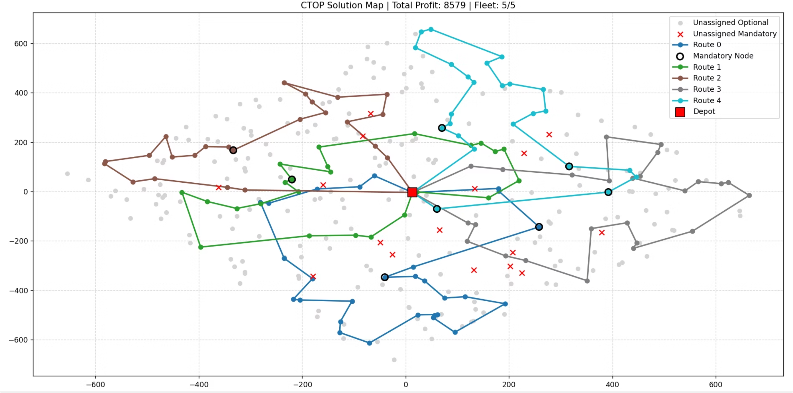
Problem 1 (No Mandatory Nodes)

Slide 12
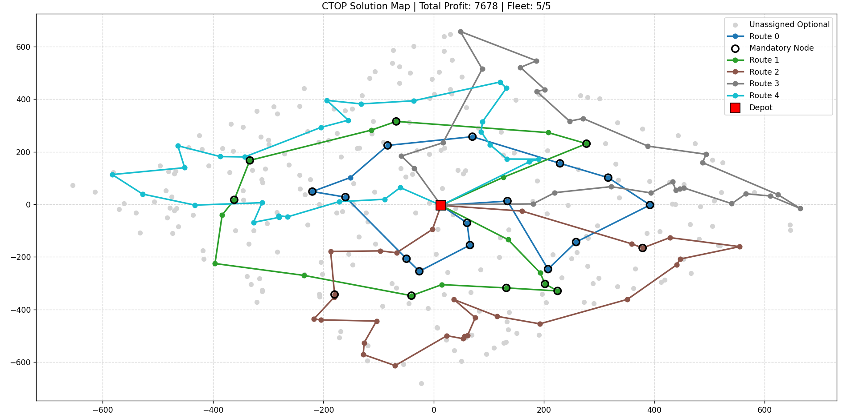
Problem 2 (Mandatory Nodes)

Slide 13

Thank You. Questions?
Final Results:
8,579
7,678
Problem 1
Problem 2
profit
profit
Team: Georgios Moschovis, Odysseas Kerasaridis, Andreas Nikolaos Kyprianou
AUEB | Operations Research & Computational Intelligence

Slide 14
References
Hammami, F. (2024). An efficient hybrid adaptive large neighborhood search method for the capacitated team orienteering problem. Expert Systems With Applications, 249, 123561. https://doi.org/10.1016/j.eswa.2024.123561
https://github.com/okerasar/CTOP-Problem

